Slide 1
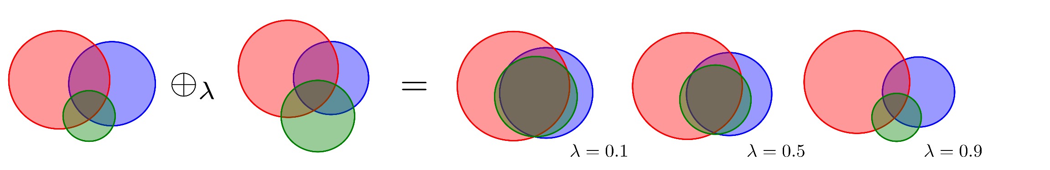

Evidence Theory
applied to Molecular Subtyping in Breast Cancer Treatment
Dr. Michael KENN

Slide 2
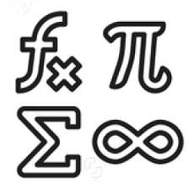


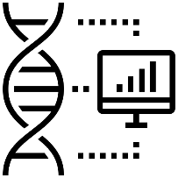






about my background
mathematics
data science
sports
astrophysics
bioinformatics
18-24
25-38
39
40-45
46-(52)

Slide 3
content
applying evidence theory to molecular subtyping of breast cancer samples
to improve methods for medical treatment
breast cancer
hormone receptors, subtypes, risks, …
evidence theory
Dempster–Shafer theory of believe functions, how to apply, …
model & results
show better ways of treatment, increase survival, …
frequently asked questions
fundamental difference to common approaches

Slide 4
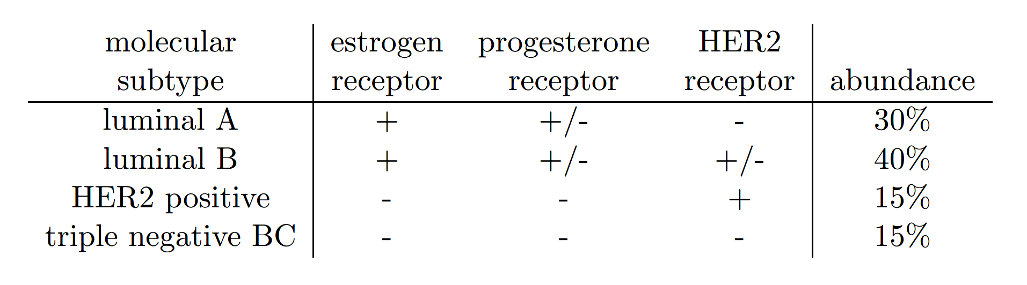
A) breast cancer – molecular subtypes

Slide 5
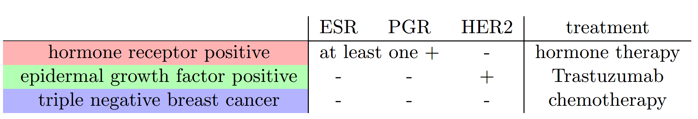
A) breast cancer - treatment

Slide 6
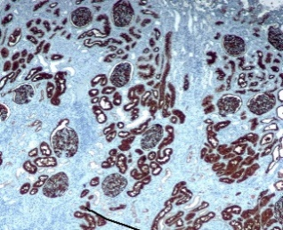
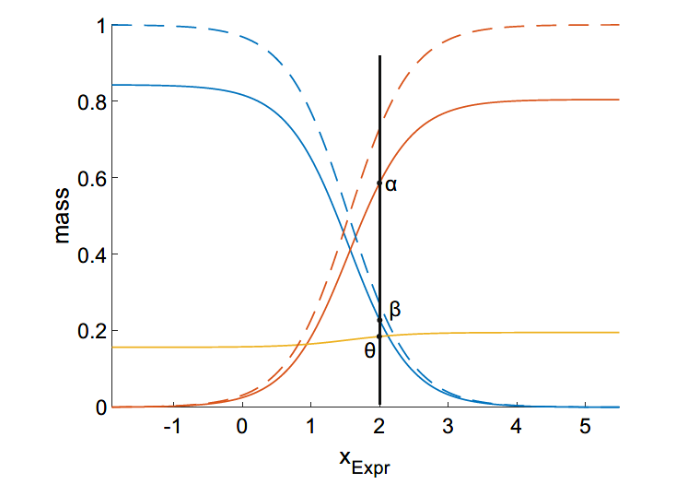

A) breast cancer - data
how to determine the three receptor status – ESR, PGR, HER2 ?
immunohistochemical measurements (IHC)
gene expression analysis of receptor genes
and co-expressed genes
clinical records
… and many more
data come from inhomogeneous sources

Slide 7
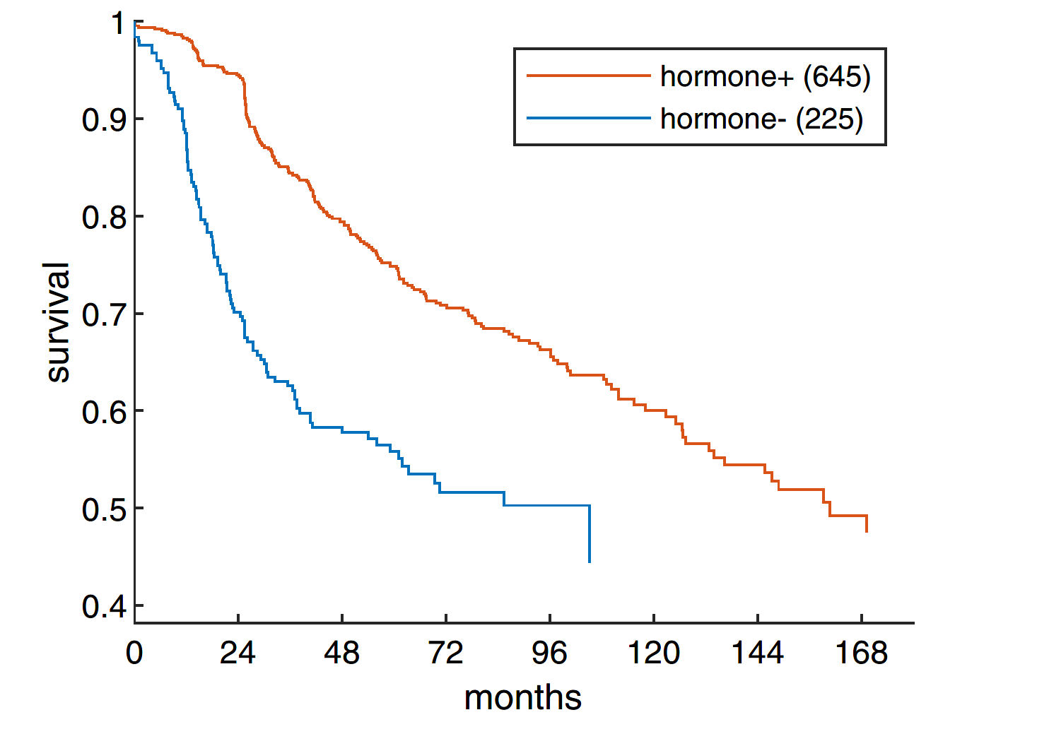
A) breast cancer - survival
possible type of therapy is essential for survival

Slide 8


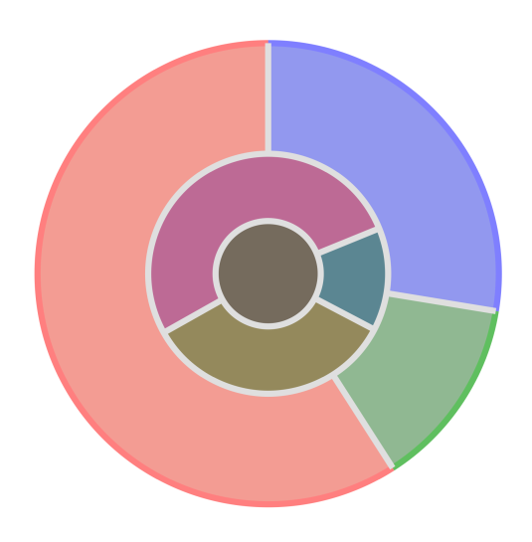
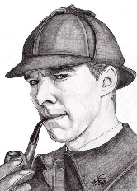
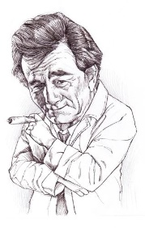
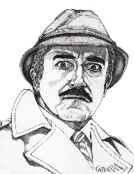
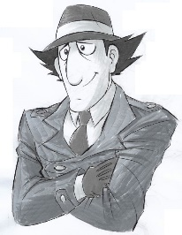

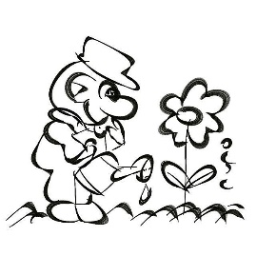
B) DST - evidence theory by Dempster-Shafer
basically a generalization of Bayesian probabilities
belief in something + more evidence ->
belief in something different
“theory of belief functions”
…
increase in belief of finding the murderer
by concatinating pieces of evidence

Slide 9
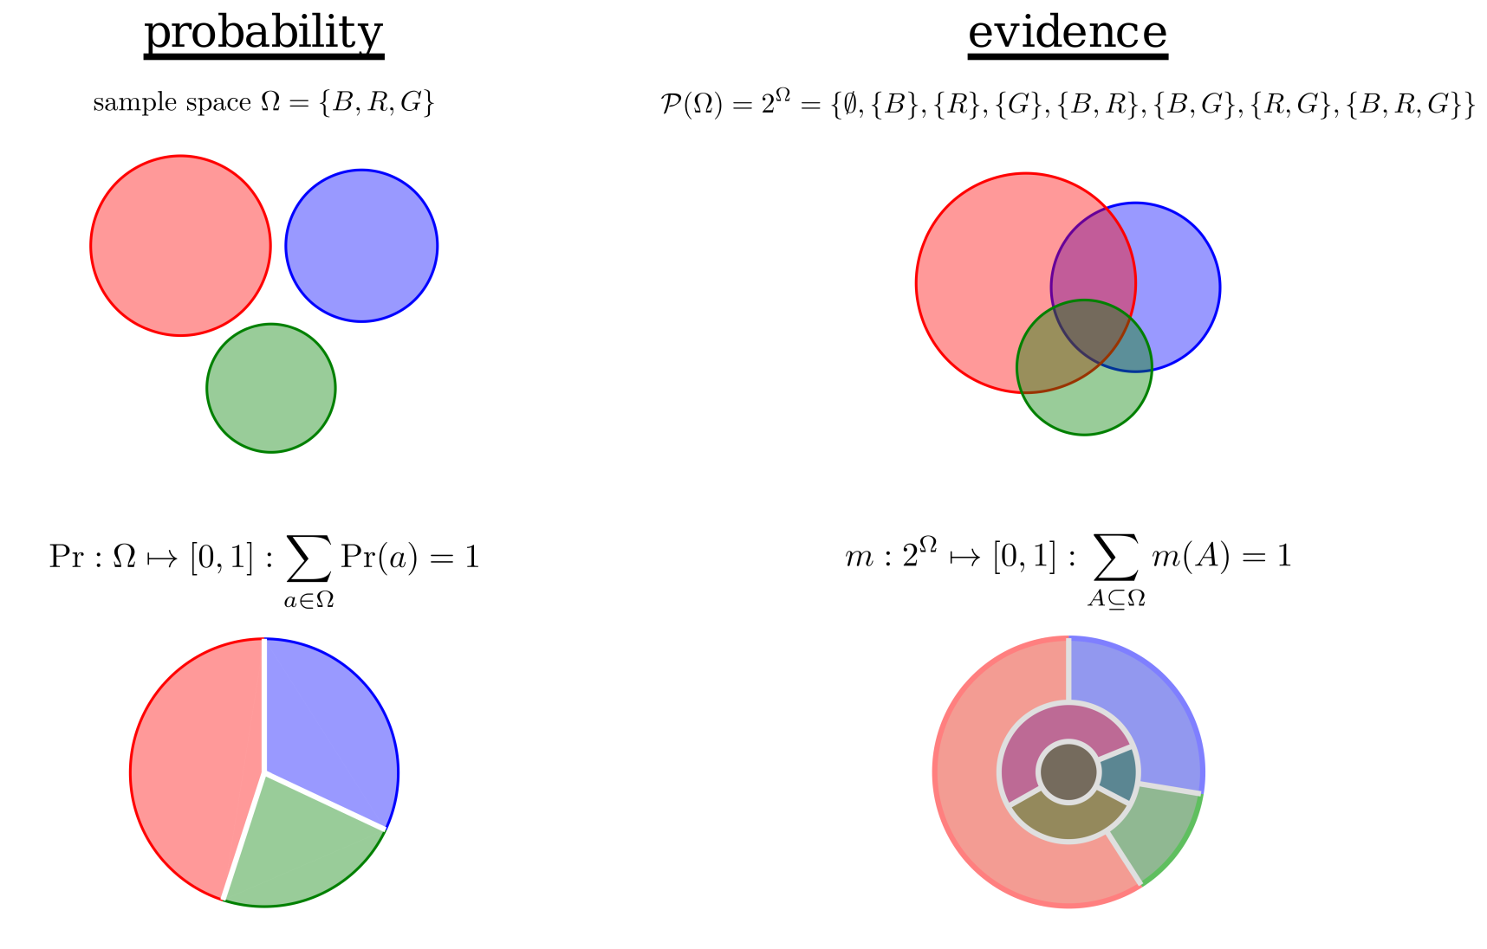

B) DST – probability vs. evidence
… sample space
… frame of discernment
probability Pr of something
belief m in
something

Slide 10
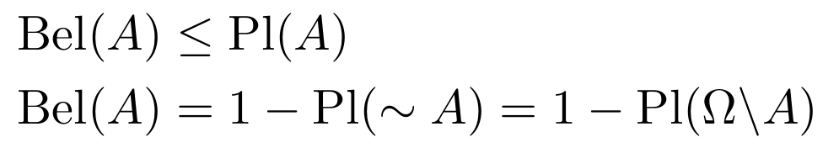
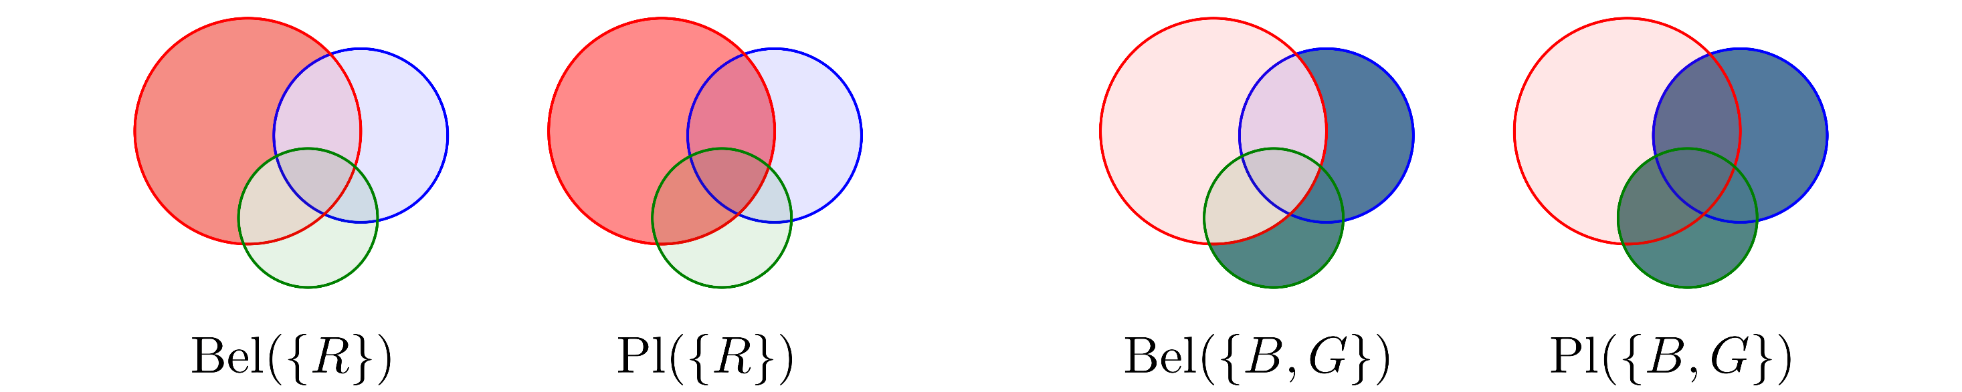
B) DST – belief & plausibilty
belief Bel(A)
mass which strictly supports proposition A
plausibility Pl(A)
mass which does not contradict proposition A

Slide 11
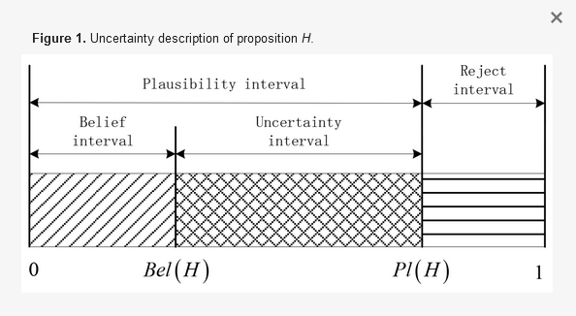
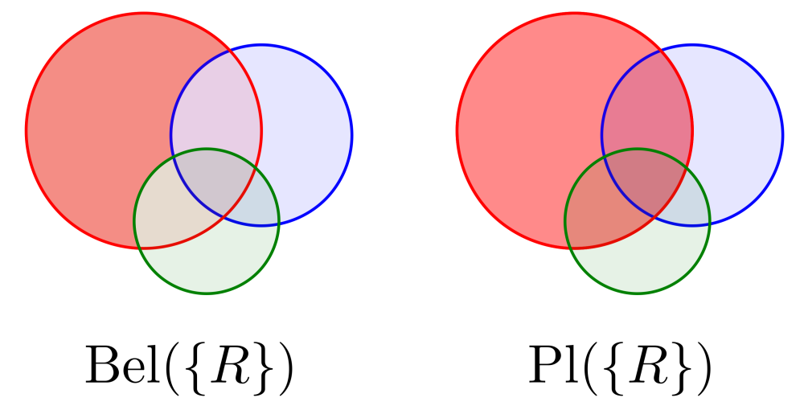



B) DST - uncertainty

Slide 12
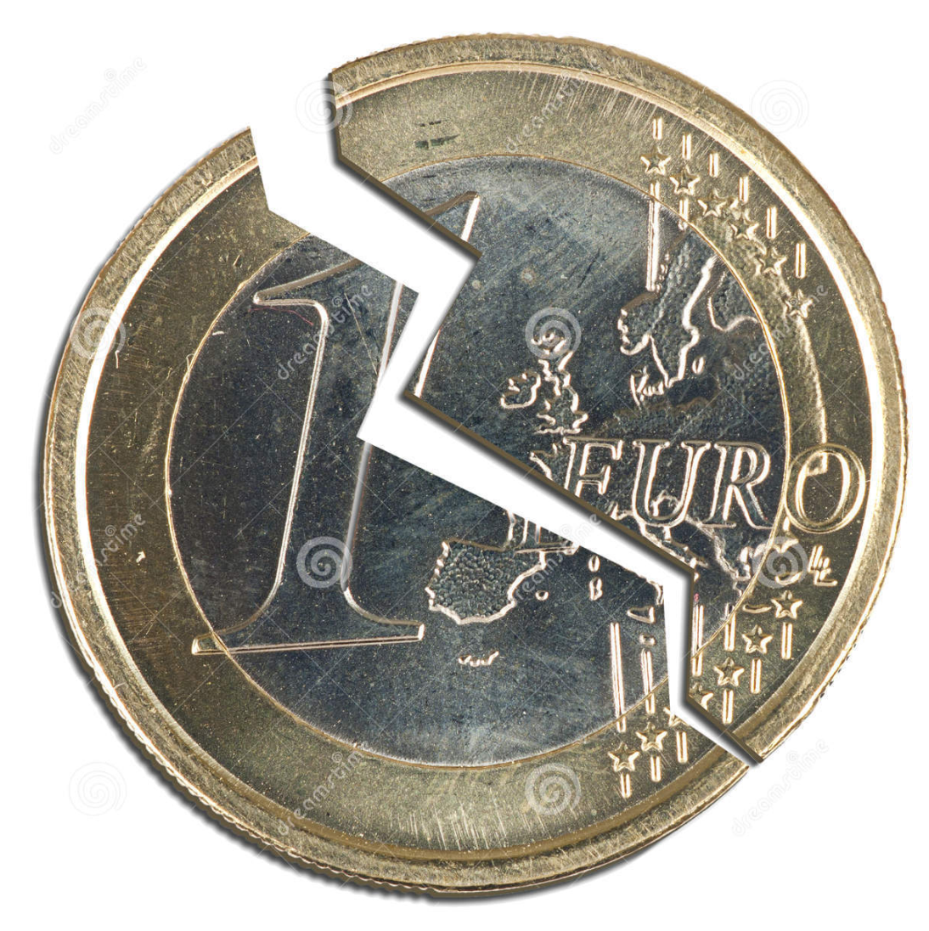
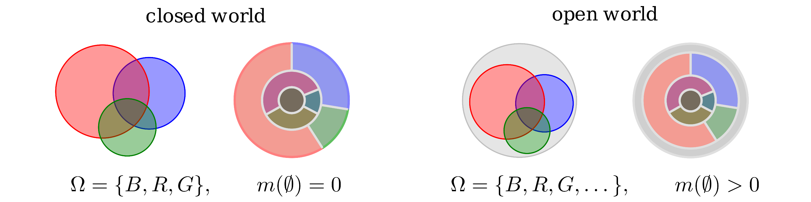
B) DST – closed vs. open world
open world assumption, e.g.
broken coin toss
someone else is the murderer
correct BC subtype, but therapy not working
…

Slide 13
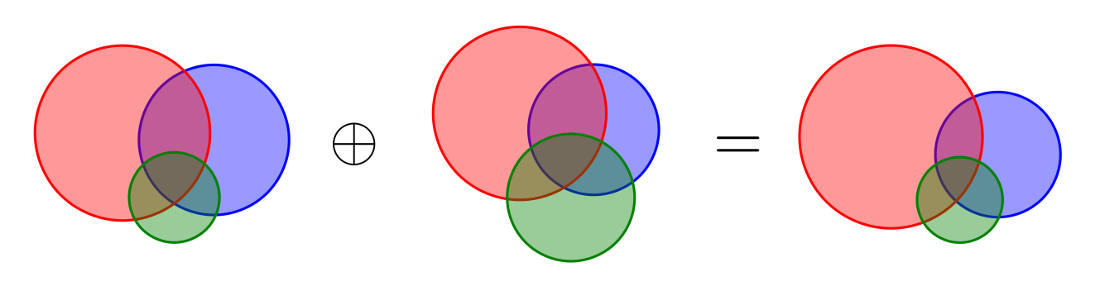
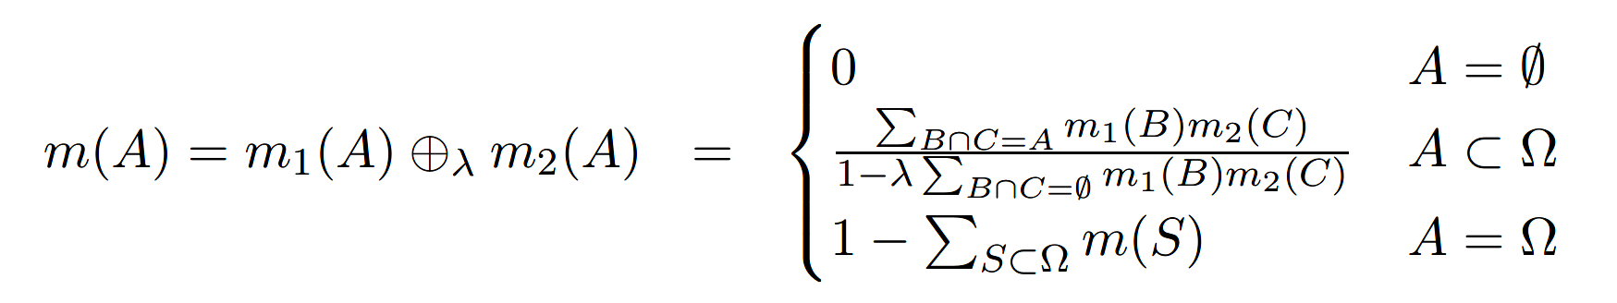
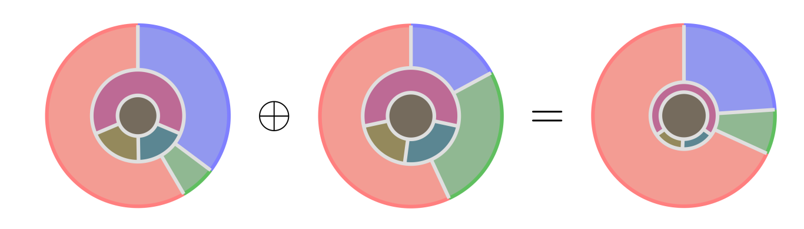
B) DST – adding evidences
pieces of evidence are linked by evidence combination rules

Slide 14
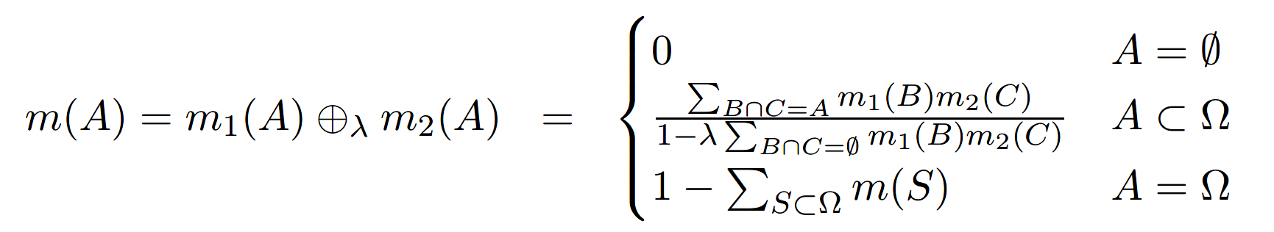

B) DST – flexible adding pieces of evidence
a parametrized evidence combination rule
it‘s this small
which matters!

Slide 15

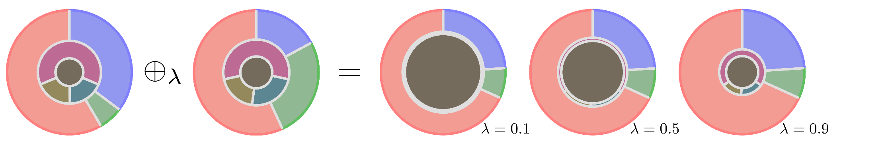
B) DST – adding consent pieces of evidence
larger
is advantageous

Slide 16
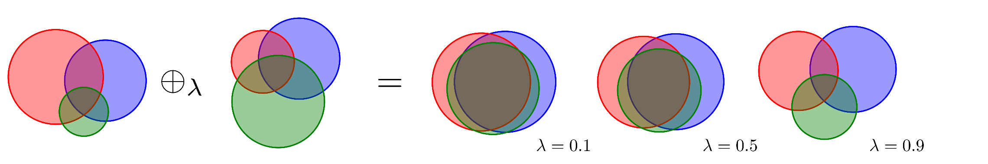
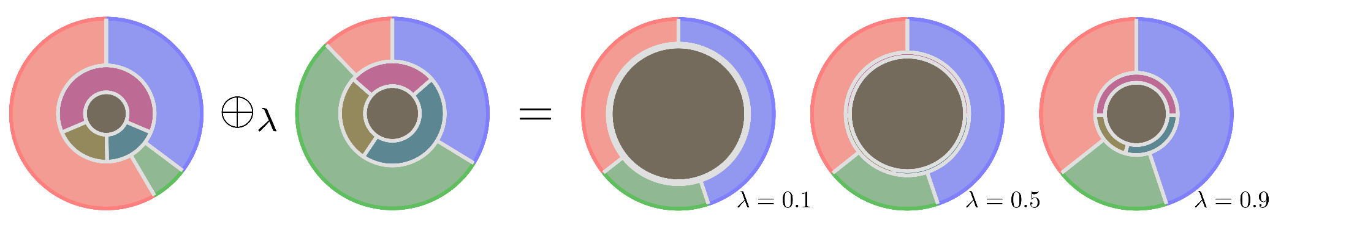
B) DST – adding contradictive pieces of evidence
smaller
is advantageous

Slide 17
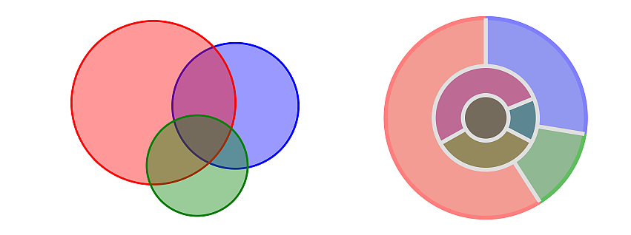
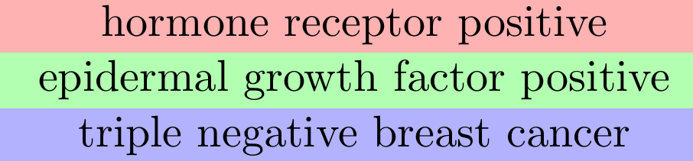
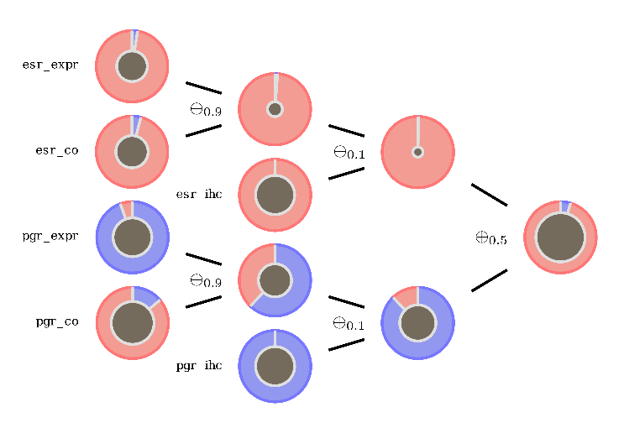

C) model & results – workflow
workflow:
data from
immunohistochemestry,
gene expression, ...
convert data into
one piece of evidence for
each source of data
basic belief masses
combine pieces of evidence by
suitable evidence combination rules
molecular subtyping
personalized
treatment

Slide 18
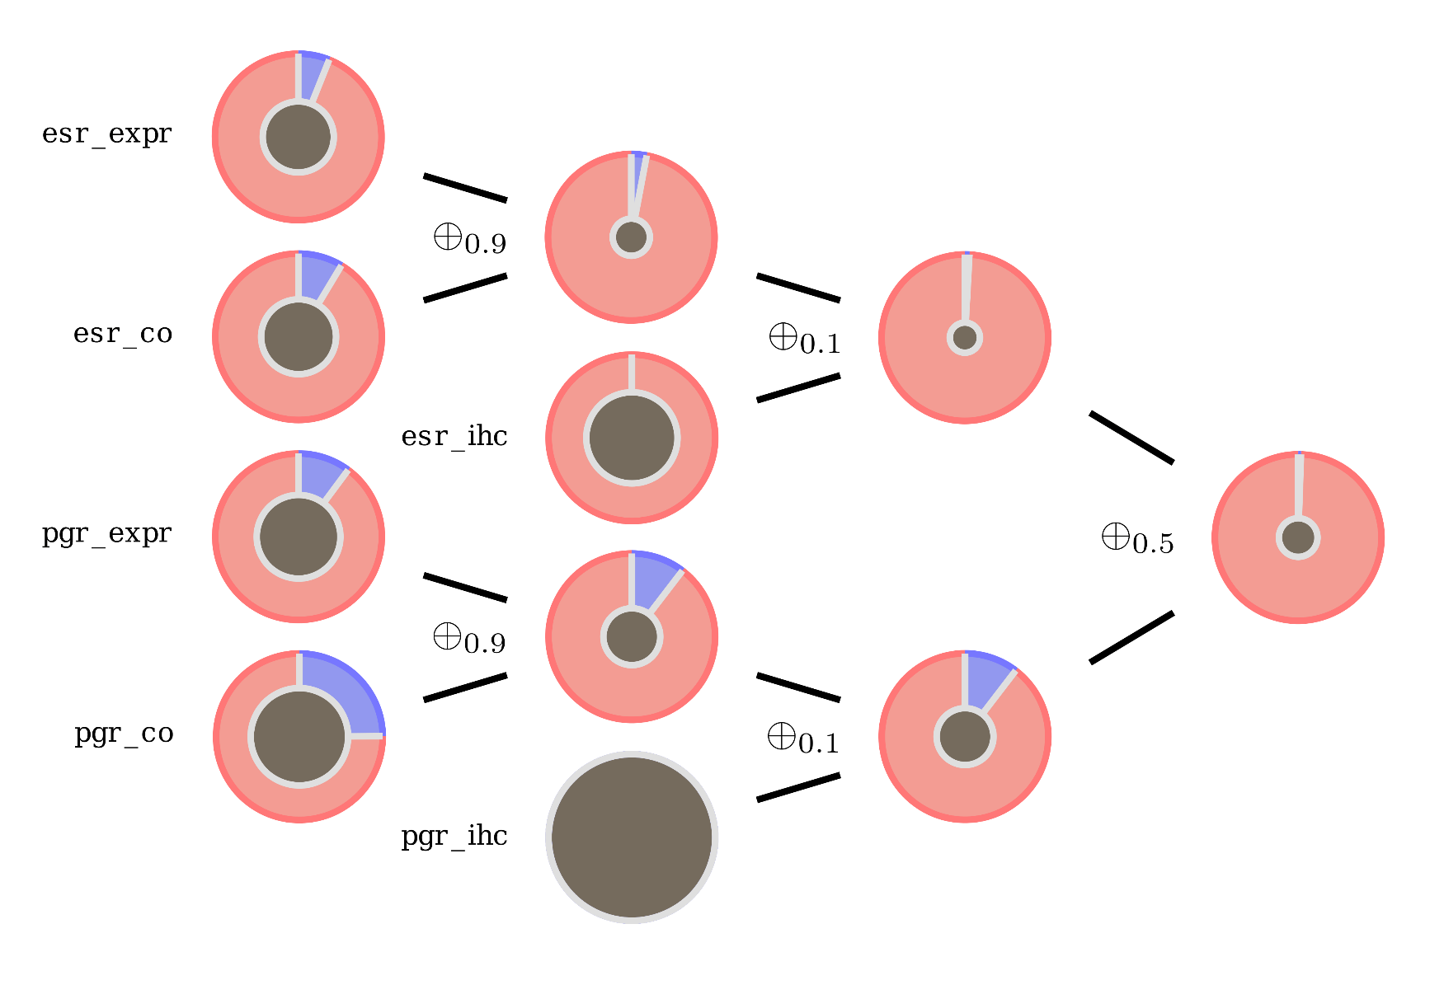
C) model & results – consent data
strong belief in hormone receptor positive (red)

Slide 19

C) model & results – contradictive data
lots of uncertainty
(gray)

Slide 20
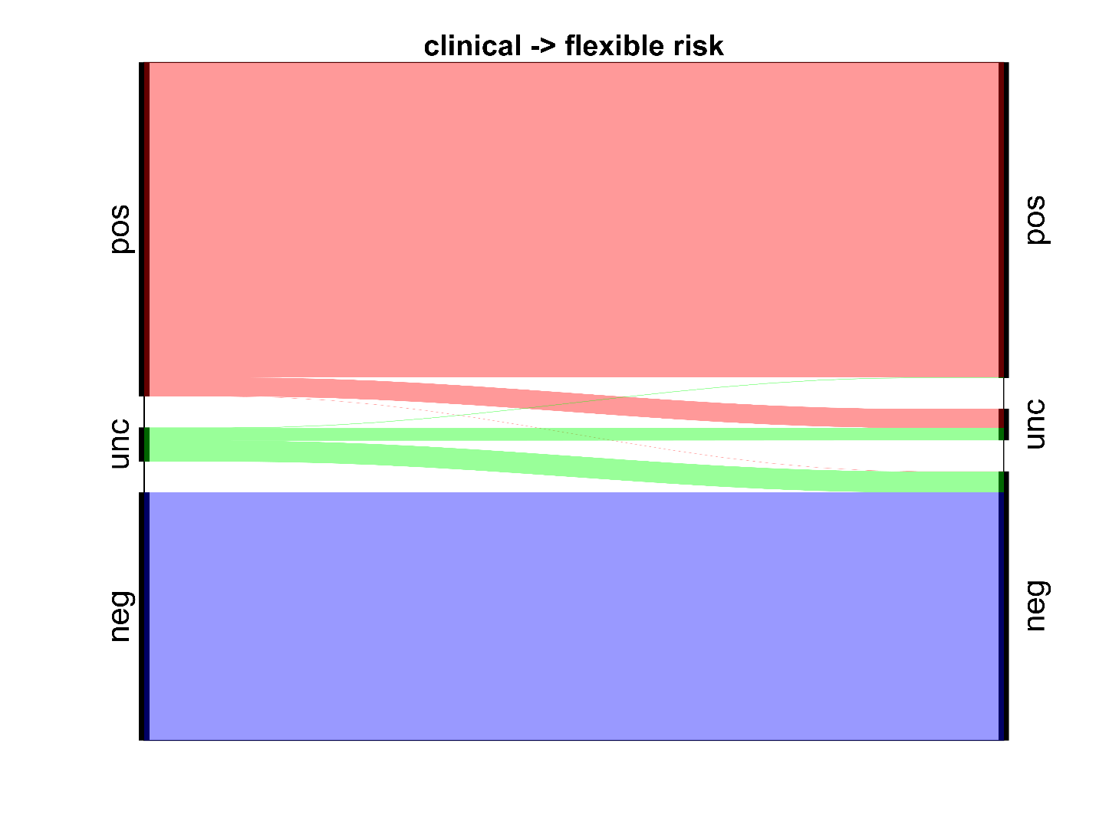
C) model & results – improvement
one essential finding by DST:
there are too many patients classified
as hormone receptor positive by conservative
clinical decision making based on IHC
vital chemotherapy treatment was eventually not carried out

Slide 21
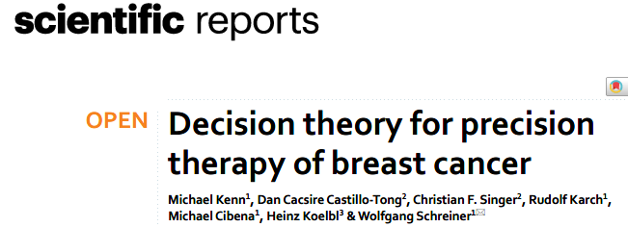
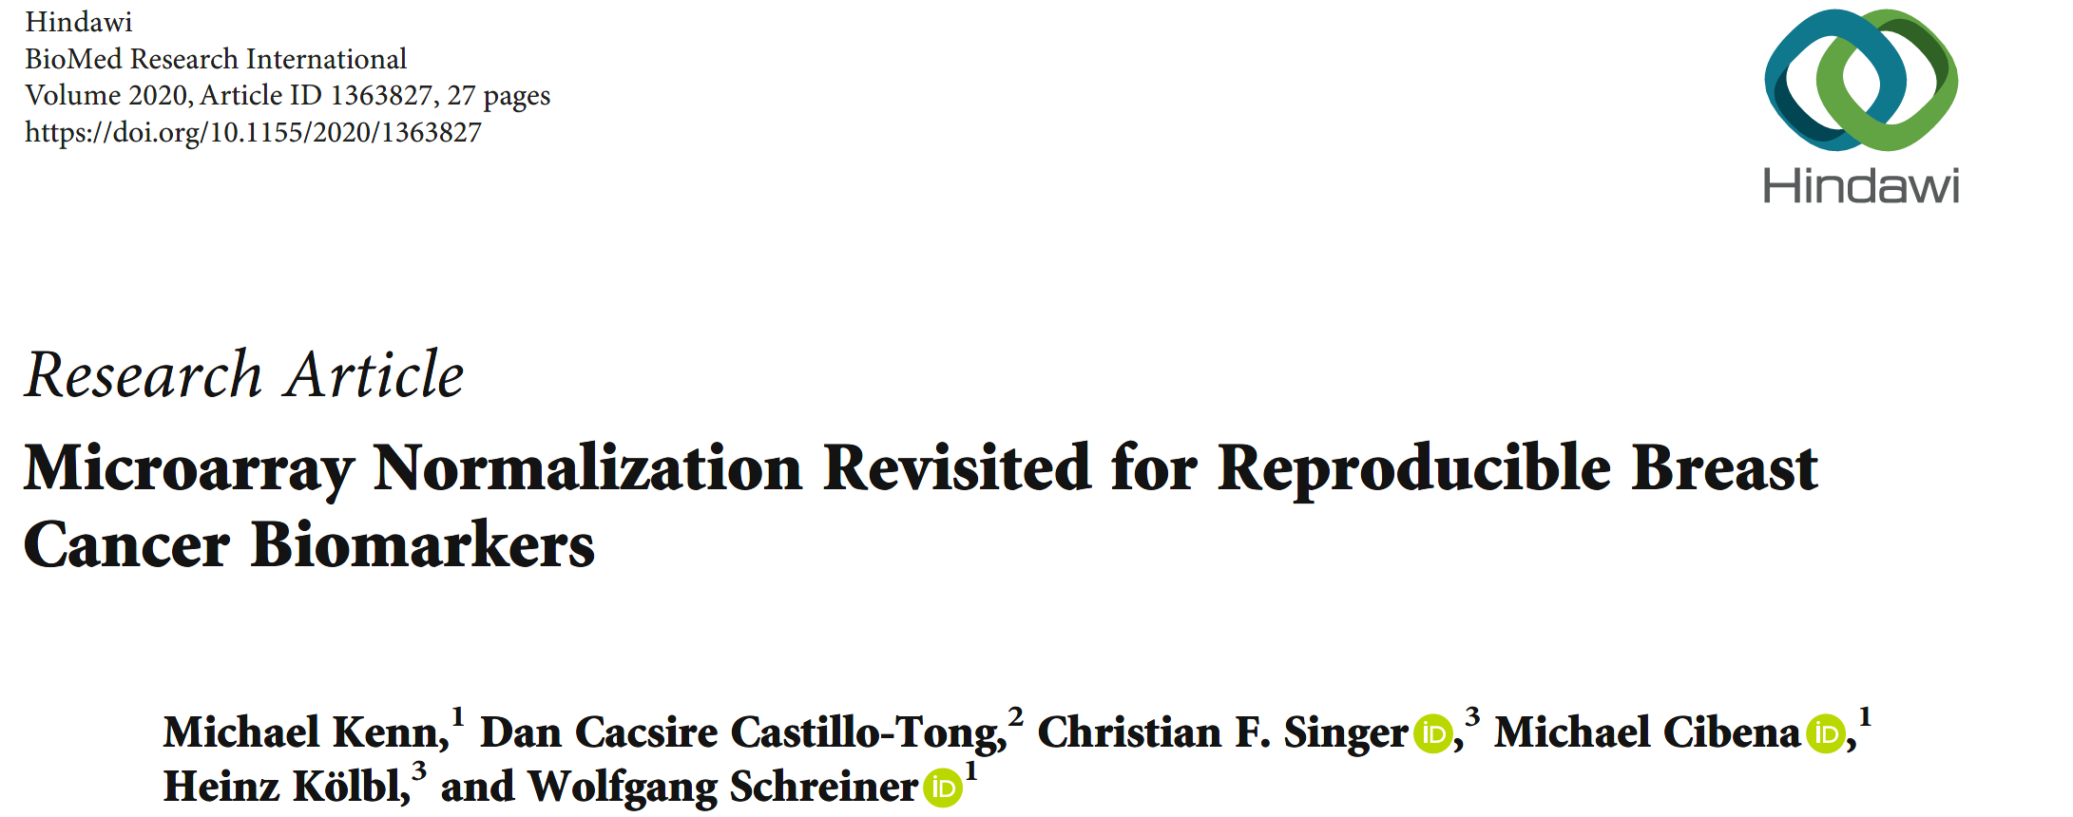
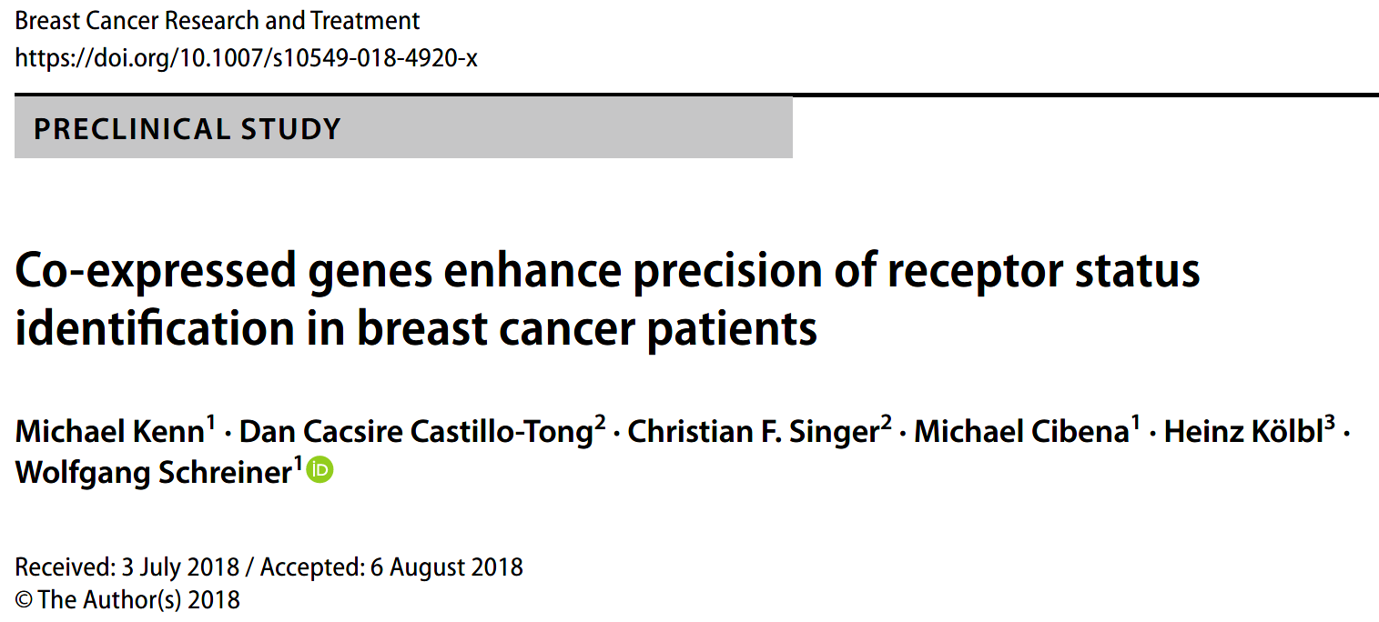
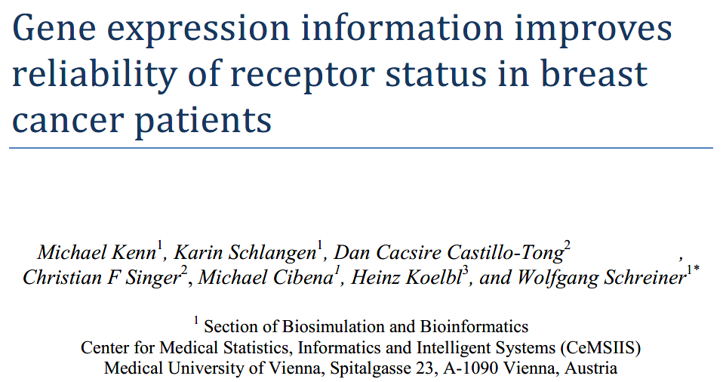
C) model & results - papers

Slide 22
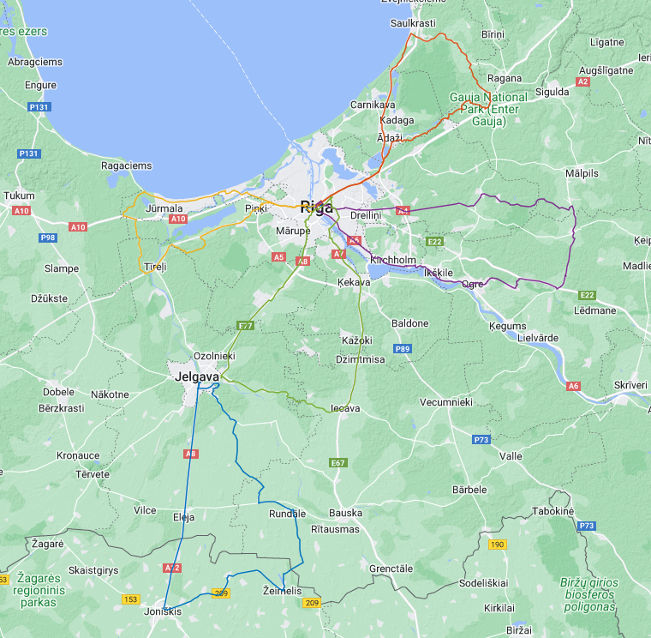
Thank you for your attention!
Michael Kenn
michael@kenn.at
https://kenn.at
https://kenn.at/trips/riga22/

Slide 23
D) frequently asked questions (FAQ)
limitations
other applications of evidence theory
similarities to fuzzy logic
advantage over more popular methods

Slide 25
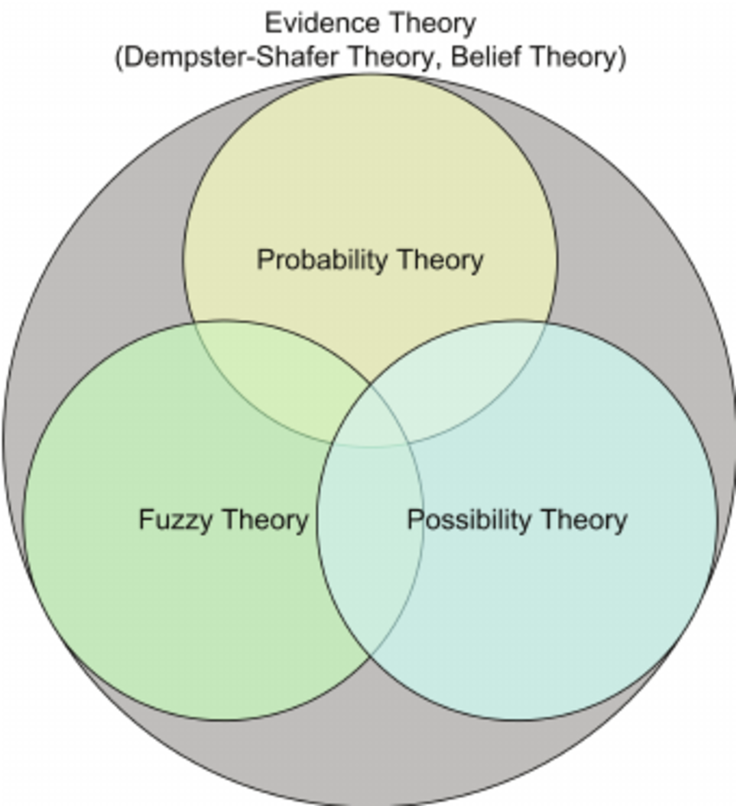
DST in a bigger frame

